Slide 1
Wednesday, October 17, 2012
No TISK or Mental Math this week.
You will fill out a post-it note for today.
You MUST bring your TEXTBOOK tomorrow.
Homework: Review your notes

Slide 2
Homework Check
16) The probability it won't be built in Zone C is 0.52.
17) The probability of not winning anything is 0.56.
18) The probabilities must have a sum of 1, but they do not have to be equal. For example, one could be 0.4 and the other could be 0.6.
9) 0.319
10) 0.35
11) 1
12) 1
13) 0.465
14) 0.535
15)
Outcome | Jamal | Elroy | Tina | Mel | Gina
Probability | 10% | 20% | 20% | 20% | 30%

Slide 3
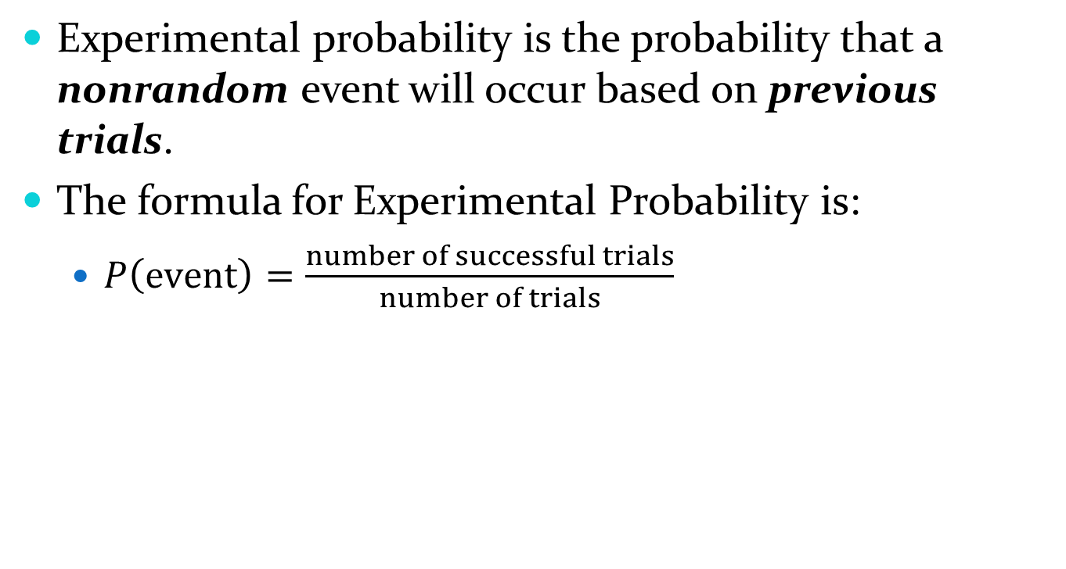
§9-2 Experimental Probability
Experimental probability is the probability that a nonrandom event will occur based on previous trials.
The formula for Experimental Probability is:
  $P\left(event\right)=\frac{number of successful trials}{number of trials}$

Slide 4
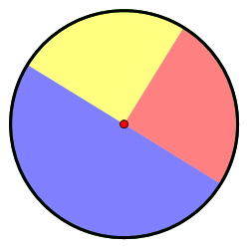
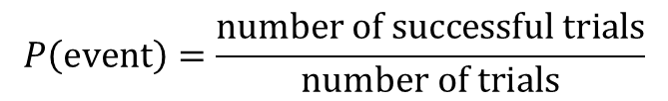
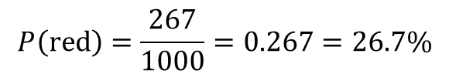
§9-2 Experimental Probability
Sometimes, experimental probability is used with random events to determine how close the probability is to the expected value or when it isn’t clear what the equally likely chances are.
  After 1000 spins of the spinner, the following information was recorded. What is the experimental probability of the spinner landing on red?
Outcome | Blue | Red | Yellow
Spins | 448 | 267 | 285
$$P\left(event\right)=\frac{number of successful trials}{number of trials}$$
$$P\left(red\right)=\frac{267}{1000}=0.267=26.7\%$$

Slide 5

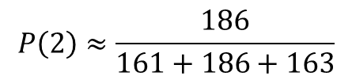
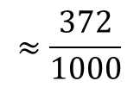
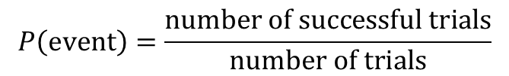
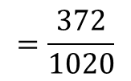


§9-2 Experimental Probability
Sometimes, you will need to estimate a normal probability using experimental data.
For instance, the table below shows the results of several spins of a spinner. Estimate the probability of spinning a 2.
$$P\left(event\right)=\frac{number of successful trials}{number of trials}$$
$$P\left(2\right)≈\frac{186}{161+186+163}$$
$$P\left(2\right)≈\frac{186}{510}$$
$$=\frac{186}{510}∙\frac{2}{2}$$
$$=\frac{372}{1020}$$
$$≈\frac{372}{1000}$$
$$≈37.2\%$$
Outcome | 1 | 2 | 3
Spins | 161 | 186 | 163

Slide 6
§9-2 Experimental Probability
Questions to think about:
  What is the difference between experimental probability and simple probability?
  How many times do you have to repeat an experiment to be sure the experimental probability is accurate?

